Slide 1
Feature Selection via Weighted Independent Domination
F. N Abu Khzam, PhD &, M. R Benabid

Slide 2
The problem
Feature Selection
MIDS
Problem statement
Improve ML model performance,
Reduce overfitting,
Enhance interpretability,
Decrease computational complexity.
Independent: no two vertices are connected
Every vertex is in the solution or is adjacent to one in the solution
Minimum and minimal
Large number of features => overfitting
Correlated features => redundancy
=> can we use MIDS to find the min #independent features that represent the dataset?

Slide 3
Proposed Model
The idea of using MIDS to find the min #features has been explored by Shu et al. (2013) via an ILP formulation, which takes exponential time.
Our model proposes a greedy max-utility heuristic that favors vertices based on their diversity level.

Slide 4
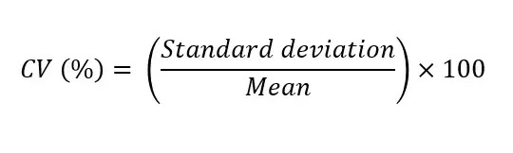
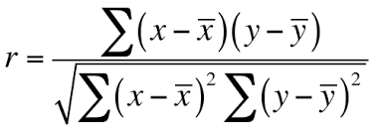
Graph construction
Vertices
Edges
How?
Vertices represent the features of the dataset and their weights are their diversity measure.
Two vertices share an edge if their assigned features are correlated.
Diversity-measure = coefficient of variation
Correlation= Pearson Correlation

Slide 5
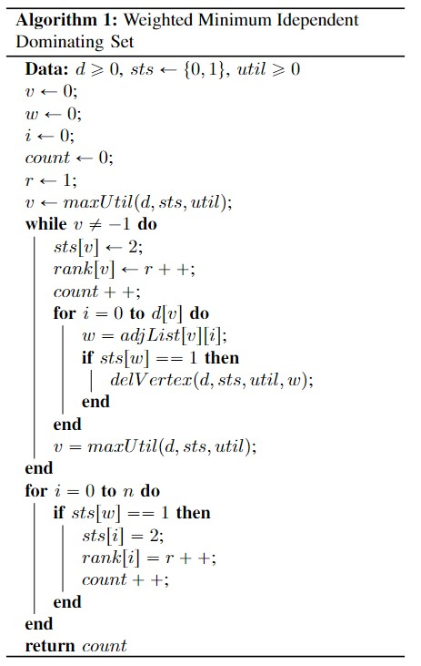
The max-utility heuristic picks the vertex with the highest sum of utility of its neighbors.
Running Time: O(n * maxDegree)

Slide 6
Feature Selection Techniques
SVM-RFE:
SVM-RFE is a feature selection method using Support Vector Machines.
Iteratively eliminates the least important features based on SVM weights,
focuses on the most informative features for classification.
Enhances model simplicity and generalization performance.
Lasso:
adding a penalty term to the linear regression objective,
promoting sparsity in coefficients. It forces some coefficients to be exactly zero,
The degree of sparsity is controlled by a regularization hyperparameter.

Slide 7
Implementation

Slide 8
Gene Expression Datasets
 | # Genes | # instances | # classes
Colon | 2000 | 60 | 2
Leukemia | 7129 | 72 | 2

Slide 9
Results

Slide 10
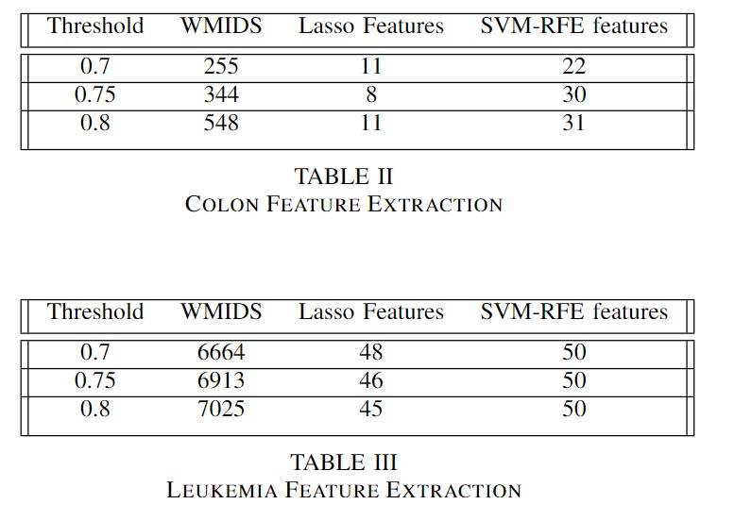
Results

Slide 11
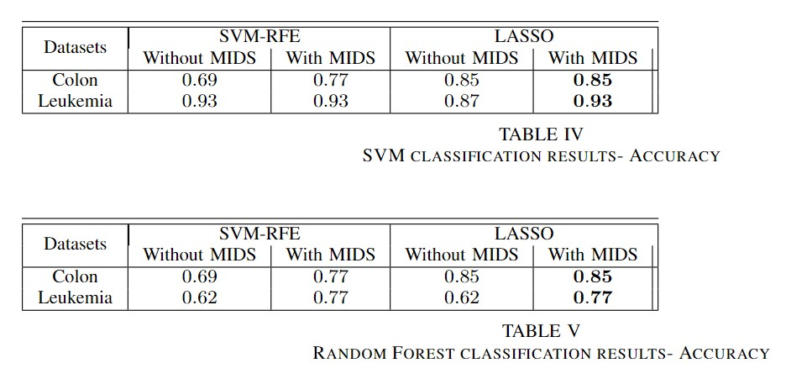
Classification Results

Slide 12
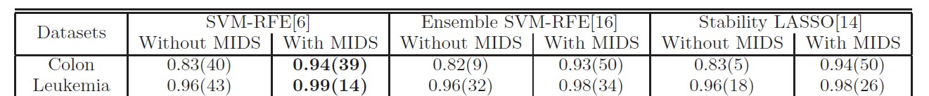
Classification Results
Meh….

Slide 13
Discussion
- Model Comparison:
- Our model differs from Shu et al. (2013) by using the max-utility heuristic for weighted MIDS, while they computed exact MIDS with ILP formulation.
- Utility Focus:
- Our model prioritizes diversity of features, asserting that diverse features are more important than less diverse ones.
- Application to Genetic Expression Data:
- Applied our diversity-focused approach to genetic expression data for tumor/cancer classification.
- Hypothesis on Genetic Diversity and Classification:
- Hypothesize that genetic diversity plays a role in determining individual susceptibility to diseases like tumors in the context of classification.

Slide 14
Discussion
- Complex Relationship:
- Acknowledge the complexity of the relationship between genetic diversity and tumor classification.
- Dependence on specific genes, tumor nature, and environmental factors influencing development.
- Genetic Variations and Tumor Risk:
- Recognize that certain genetic variations may be linked to increased tumor risk, while others may confer resistance or resilience.
- Crucial Understanding for Diagnosis:
- Emphasize the importance of understanding the interplay between genetic diversity and tumor classification for effective diagnostic strategies.
- Caution on Gene Diversity Significance:
- Conclude that diversity of certain genes doesn't necessarily imply significance for diagnosis, suggesting a nuanced interpretation.

Slide 15
Conclusion
While our approach did not give the best results, it still made significant improvement in classification accuracy.
The work suggests a novel feature selection method using weighted minimal independent dominating set, improving algorithm performance and prediction accuracy.

Slide 16
Thanks!
max growth

Slide 17
References
Shu, L., Ma, T., and Latecki, L. J., “Stable feature selection with minimal independent dominating sets,” in Proceedings of the International Conference on Bioinformatics, Computational Biology and Biomedical Informatics, ser. BCB’13. New York, NY, USA: Association for Computing Machinery, 2013, p. 450–457. [Online]. Available: https://doi.org/10.1145/2506583.2506600

